Slide 1
Audio-Based Stress Detection through Deep Learning
Semester-5
Group Number - 8
Prepared By:
IIT2021163 - Saransh Gupta
IIT2021153 - Aryan Pandey
IIT2021122 - Jai Moryani
IIT2021152 - Sumit Prakash
IIT2021131 - Harsh Sharma
IIT2021191 - Kushagra Jain
IIT2021162 - Saransh Yadav
Mentored By:
Prof. Anupam Agrawal

Slide 2

Contents
01
02
03
04
05
06
Introduction
Project Scope
Objectives
Literature Review
Challenges
Dataset

Slide 3

Contents
07
08
09
10
11
12
13
Framework
Implementation
GUI Implementation
Results
Future Scope & Limitations
Conclusion
References

Slide 4
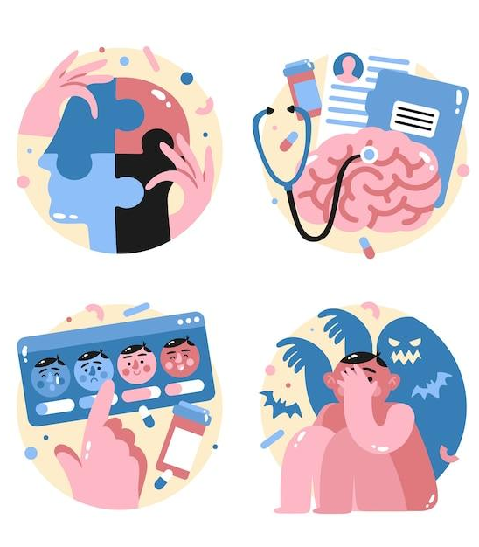
01
Introduction

Slide 5
Abstract
The precise detection and management of stress have gained significant attention due to its broad relevance in fields like mental health, human-computer interaction, and personalized well-being services. This presentation introduces a novel approach, "Audio-Based Stress Detection through deep learning model LSTM," to advance stress detection methodologies.
Our proposed technique combines pitch recognition and deep learning models, including Convolutional Neural Networks (CNN), Deep neural networks (DNN) and Long Short-Term Memory networks (LSTM). This approach offers a comprehensive understanding of stress levels, providing a more nuanced and objective assessment of emotional states.

Slide 6
Motivation
In this presentation, we delve into the intricate details of this innovative approach, highlighting its potential to enhance our comprehension of stress patterns and provide a foundation for effective stress management strategies. We present a comprehensive analysis of the techniques and architecture, discussing its methodologies, benefits, and the broader implications it holds. Through this exploration, we aim to pave the way for a more holistic and data-driven approach to stress assessment and mitigation.
The potential impact is profound, revolutionizing stress assessment, enabling early intervention, and ultimately contributing to enhanced well-being.

Slide 7
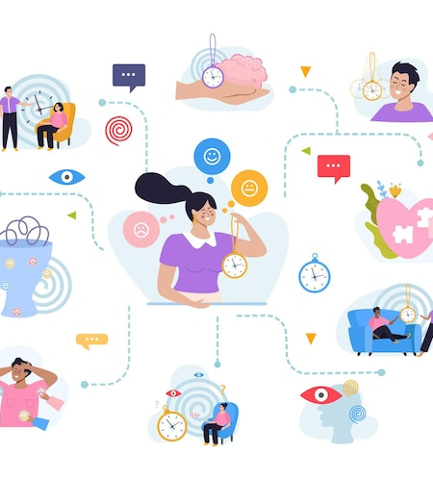
02
Project Scope

Slide 8
Project Scope
Problem Statement: The project aims to develop a stress detection system using audio data from the extended DAIC-WOZ dataset. The primary goal is to create a model capable of identifying stress in individuals using a limited dataset.
01
Data Collection and Preprocessing: The initial dataset consists of 153 audio instances, with an imbalanced class distribution (46 stressed, 107 not stressed). The data will be preprocessed, including audio trimming to standardize the length.
02
Model Training: Deep neural networks (DNN), convolutional neural networks (CNN), and long short-term memory networks (LSTM) will be trained on the extracted features. Evaluation metrics will be used to assess the model’s performance on the dataset.
03
Model Evaluation and Improvement: Model performance will be evaluated using metrics such as accuracy, precision, recall and F1-score. Techniques like cross-validation, hyperparameter tuning, and model ensembling may be employed to improve model performance.
04

Slide 9

03
Objectives

Slide 10
Objectives
01
Comparative Analysis with State-of-the-Art Techniques: Conduct a comprehensive literature review to identify and understand the state-of-the-art techniques in audio-based stress detection. Implement and evaluate our proposed CNN-DNN-LSTM model against benchmark models from the literature, considering key performance metrics such as accuracy, precision, recall, and F1 score.
02
Extensive Data Augmentation for Robust Model Training: Apply a range of data augmentation techniques, including time warping, pitch shifting, and noise injection, to artificially expand the DAIC WOZ dataset. Quantitatively assess the impact of augmented data on model performance, specifically focusing on improvements in generalization and the model's ability to handle variations in stress-related audio patterns.
03
Feature Engineering and Comparative Analysis: Explore various feature extraction methods for stress-related audio signals, including spectrogram-based features and statistical measures. Compare the performance of our proposed feature extraction techniques with traditional methods, such as Mel-frequency cepstral coefficients (MFCCs), to identify the most informative features for stress detection in the DAIC WOZ dataset.

Slide 11
Objectives
04
Temporal Context Learning with Long Short-Term Memory (LSTM): Enhance the LSTM architecture to capture long-term dependencies in stress-related audio sequences. Investigate optimal sequence lengths, memory cell configurations, and attention mechanisms to improve the model's understanding of temporal dynamics and nuanced patterns associated with stress.
05
Addressing Class Imbalance: Develop and implement strategies to address class imbalance in stress and non-stress labels within the DAIC WOZ dataset. Investigate techniques such as oversampling, undersampling, or the use of weighted loss functions to ensure the model effectively learns from both classes, preventing bias toward the majority class.
06
Real-World Applicability and User Feedback: Deploy the trained model in a simulated real-world environment, involving potential end-users and stakeholders. Collect qualitative feedback on the model's usability, interpretability, and overall performance. Incorporate user input to iteratively refine the model and enhance its practical utility in stress detection applications.

Slide 12

04
Literature Review

Slide 13
Literature Review[1][2][3]
Audio-based stress detection using deep learning is an emerging and promising field of research. Deep learning techniques, particularly neural networks, have shown significant potential in automatically identifying stress and related emotional states from audio data.
Deep neural networks, including Convolutional Neural Networks (CNNs), Recurrent Neural Networks (RNNs), and more recently, Transformers, have been used to extract features and model patterns from audio data related to stress. CNNs are often used for feature extraction from spectrograms, while RNNs are employed for sequential data analysis.

Slide 14
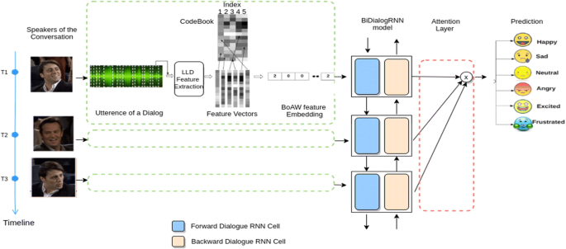
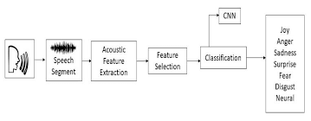
Realtime Stress-Detection based on audio processing.

Slide 15
Literature Review[1][2][3]
Review of Selected Studies :
Audio based depression detection using Convolutional Autoencoder(Sara Sardari, Bahareh Nakisa, Mohammed Naim Rastgoo, Peter Eklund) : The paper introduces an efficient audio-based Automatic Depression Detection (ADD) framework, leveraging a Convolutional Neural Network-based Autoencoder (CNN AE) for feature extraction. Overcoming challenges of hand-crafted features, the proposed method significantly improves depression identification accuracy. Employing cluster-based sampling to address sample imbalance, the framework outperforms existing models, demonstrating a minimum 7% improvement in F-measure for depression classification on the DAIC-WOZ dataset.

Slide 16
Literature Review[1][2][3]
Review of Selected Studies :
End-to-end multimodal clinical depression recognition using deep neural networks: A comparative analysis(Muhammad Muzammel, Hanan Salamb, Alice Othmani): This literature review evaluates multimodal depression recognition, focusing on audio-based Convolutional Neural Networks (CNNs) and Long Short-Term Memory (LSTM). Results show LSTM-based audio features slightly outperform CNNs for binary depression classes. Model-level fusion of deep audio and visual features using LSTM achieves the highest accuracy (77.16%), outperforming state-of-the-art approaches on the DAIC-WOZ dataset with an accuracy of 95.38% for binary depression detection. This architecture, with a speech segment under 8 seconds and a prediction time under 6ms, is suitable for real-world clinical applications.

Slide 17
Literature Review[1][2][3]
Review of Selected Studies :
Speech Emotion Analysis Using Machine Learning for Depression Recognition(S Bhavya, Royson Clausit Dmello, Ashish Nayak and Sakshi S Bangera) : This literature review covers various approaches to depression detection using speech. The first method utilizes acoustic features and classifiers on the DAIC-WOZ database, achieving 90% accuracy with the CureD app. Another approach employs an SVM classifier for voice data, reaching 85% accuracy and demonstrating clinical feasibility. The third method proposes a deep Recurrent Neural Network-based framework, achieving 76.27% accuracy through multimodal tests and augmentation techniques on the DAIC-WOZ dataset.

Slide 18
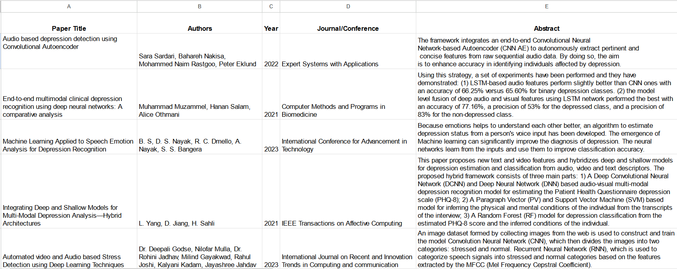
Literature Review[1][2][3]

Slide 19
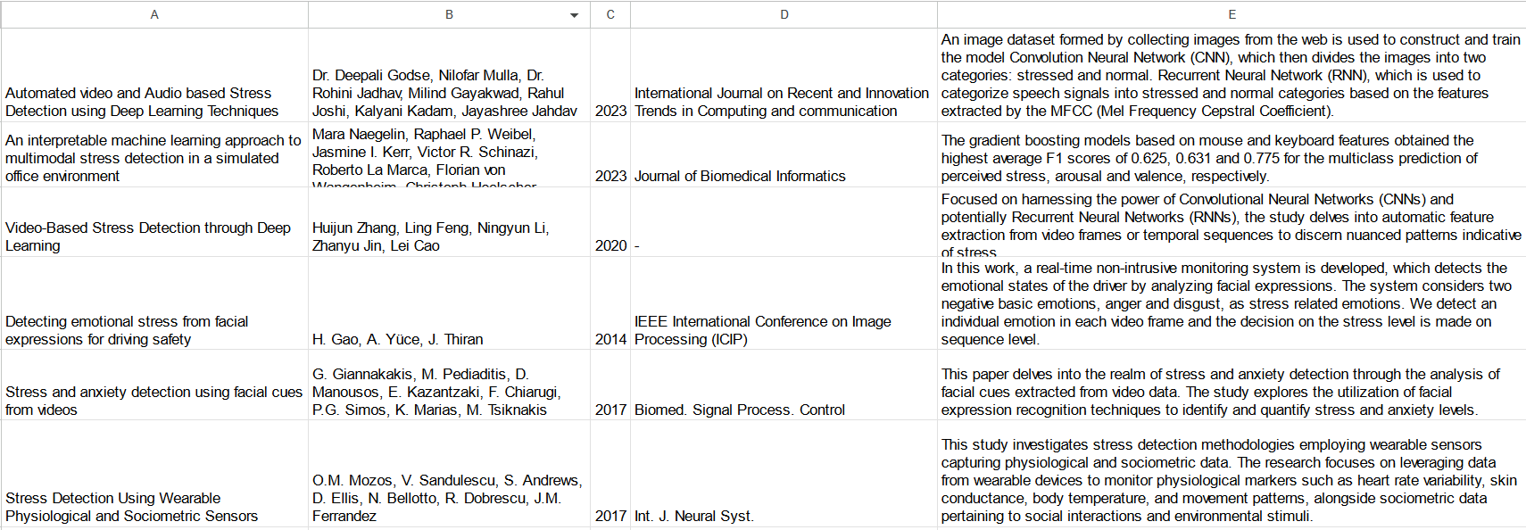
Literature Review[1][2][3]

Slide 20
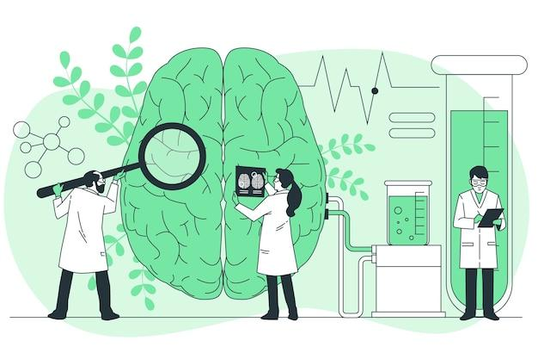

05
Challenges

Slide 21
Challenges/ Knowledge gaps[1][3]
Feature Extraction Challenges: The research by Sara Sardari et al. using Convolutional Autoencoders highlights the complexity of feature extraction from audio data. Identifying meaningful features related to depression in audio signals remains a challenge due to the variability of speech patterns among individuals experiencing depression.
Dataset Limitations: Across these studies, a common challenge is the availability and quality of labeled datasets specific to audio-based depression detection. Limited access to large, diverse, and well-annotated datasets impedes the development and validation of robust machine learning models for depression detection from audio.

Slide 22
Challenges/ Knowledge gaps[1][3]
Ambiguity in Emotional Analysis: The paper by B. S et al. focusing on speech emotion analysis for depression recognition highlights the challenge of distinguishing between various emotions, including those related to depression, in audio signals. The ambiguity in emotional expressions complicates the accurate identification of depressive states solely based on speech features.
Generalization and Contextual Understanding: A collective challenge from these papers involves the generalization of models across diverse demographics, languages, and cultural contexts. Ensuring that models can effectively detect depression across different populations without biases or overfitting remains a hurdle.

Slide 23
06
Dataset

Slide 24
Data Collection https://dcapswoz.ict.usc.edu/wwwedaic/
Extended DAIC-WOZ Database :
The Extended DAIC (Distress Analysis Interview Corpus) WOZ (Wizard of Oz) dataset is a collection of audiovisual recordings of interviews designed for the study of depression and post-traumatic stress disorder (PTSD).
It was created as part of the Audio/Visual Emotion Challenge and Workshop (AVEC) series.The dataset includes video and audio recordings of interviews between a human interviewer and a subject who simulates a distressed person.
The interviews are designed to elicit responses indicative of depression and PTSD. The "Wizard of Oz" component refers to the fact that some of the responses were simulated by human operators (wizards) who controlled the virtual agent's responses during the interviews.

Slide 25
Data Collection
Extended DAIC WOZ Dataset for Audio-Based Stress Detection:
Data Source: Multimodal dataset including audio recordings from distress interviews. Simulated distress scenarios with annotations for ground truth.
Key Features for Audio Analysis:
Pitch and Prosody: Changes indicate emotional states, including stress.
Speech Rate: Variations linked to stress levels.
Energy and Loudness: Increased energy and loudness associated with stress.
MFCCs (Mel-Frequency Cepstral Coefficients): Capture spectral characteristics in stress-related speech.
Annotations:
Dataset annotated with labels indicating distress and emotional states.
Provides ground truth for training and evaluating stress detection models.

Slide 26
Imbalanced Data
Our initial dataset for stress detection, the DAIC WOZ dataset, was small and unbalanced, with 153 audio samples of 107 instances of not stressed class, primarily consisting of 47 instances in the stressed class.
To deal with the unbalanced data, we have done over-sampling.
Given data scarcity and the infeasibility of collecting more instances, under-sampling was not pursued due to the risk of significant data reduction.
Consequently, we opted to train our models on the unbalanced data to maximize information utilization.
Our approach involved extracting audio features, including chromagrams, spectrograms, and Mel spectrograms, from trimmed audio files, resulting in 192 features per audio WAV file.
These features served as the foundation for training deep neural networks (DNN), convolutional neural networks (CNN), and long short-term memory networks (LSTM) for stress detection.

Slide 27
Data Preprocessing
Data Augmentation(pitch shifting, time stretching, and Gaussian noise addition) :
Pitch Shifting: Pitch shifting alters the frequency (pitch) of the audio signal without changing its duration.
Implementation: Achieved by resampling the audio signal, either by interpolation or using specialized algorithms. Effect: Raises or lowers the perceived pitch of the audio.
Time Stretching: Time stretching adjusts the speed or duration of the audio signal without affecting its pitch.
Implementation: Involves resampling the audio, often using algorithms like the Phase Vocoder.
Effect: Speeds up or slows down the playback speed of the audio while maintaining its pitch.

Slide 28
Data Preprocessing
Data Augmentation(pitch shifting, time stretching, and Gaussian noise addition) :
Gaussian Noise Addition: Adding Gaussian noise involves introducing random values from a Gaussian distribution to the audio signal.
Implementation: Superimposing small, randomly generated values to the audio samples.
Effect: Mimics the presence of background noise, making the model more robust to different acoustic environments.
Use Case: Useful for simulating real-world scenarios where audio recordings may have varying levels of background noise.

Slide 29
Feature Extraction
Our approach involves extracting audio features, including chromagrams, spectrograms, and Mel spectrograms, from trimmed audio files. A total of 192 features were extracted from each audio WAV file.
Here are some of the most common audio features:
MFCCs (Mel-frequency cepstral coefficients):
Number of Features: 13
Explanation: These coefficients represent the shape of the spectral envelope of the audio signal at different frequencies. They capture aspects of the audio signal related to timbre and are commonly used in speech and audio processing.
Delta features (First-order differences of MFCCs):
Number of Features: 13 (derived from MFCCs)
Explanation: Delta features represent the rate of change of MFCCs over time and provide information about the dynamics or speed of changes in the audio signal.

Slide 30
Feature Extraction
Double-delta features (Second-order differences of MFCCs):
Number of Features: 13 (derived from MFCCs)
Explanation: Double-delta features capture the acceleration or curvature of changes in MFCCs over time, providing additional information about the dynamics of the audio signal.
Chroma features:
Number of Features: Typically 12
Explanation: Chroma features represent the energy distribution of pitch classes in the audio signal, providing information about the tonal content and musical characteristics.

Slide 31
Feature Extraction
Mel spectrogram features:
Number of Features: Depends on the number of mel bins used
Explanation: Mel spectrogram features represent the energy distribution across mel-frequency bands, giving a compact representation of the spectral content of the audio signal.
Spectral contrast features:
Number of Features: Depends on the number of contrast measures used
Explanation: Spectral contrast features quantify the difference in amplitude between peaks and valleys in the spectrum, capturing variations in spectral texture and emphasis.

Slide 32
Feature Extraction
Tonnetz features (Tonal centroid features):
Number of Features: Typically 6
Explanation: Tonnetz features represent the tonal characteristics of the audio signal and provide information about harmonic relations and musical content.
Link for the feature extracted files -
https://drive.google.com/drive/u/0/folders/1WwKpBljcD_2CgXbujY2-mIRkmMlRcJ4G

Slide 33

07
Framework

Slide 34
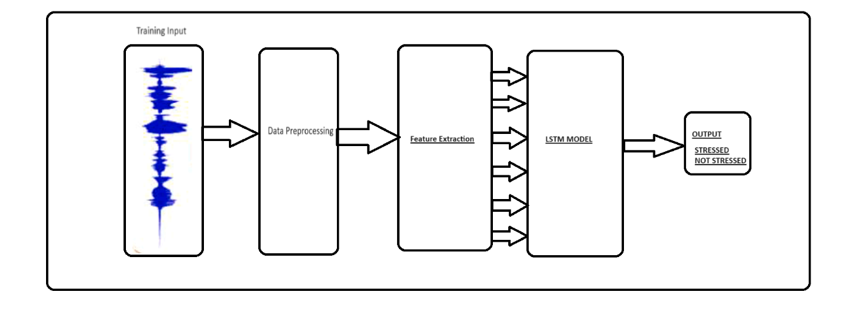
General Overview of Proposed Model

Slide 35
Deep Neural Networks(DNNs)[1][2]
Deep Neural Networks Overview
Introduction:
Deep Neural Networks (DNNs) are a class of artificial neural networks with multiple layers.
They are designed to automatically learn hierarchical representations of data.
Architecture:
Input Layer: Initial data input.
Hidden Layers: Intermediate layers for feature learning.
Output Layer: Final prediction or classification.

Slide 36
Deep Neural Networks(DNNs)[1][2]
Deep Neural Networks Overview
Activation Functions:
Activation functions (e.g., ReLU, Sigmoid) introduce non-linearity, enabling the network to learn complex patterns.
Training Process:
Backpropagation optimizes model weights based on the difference between predicted and actual outcomes.Gradient descent is commonly used for optimization.

Slide 37
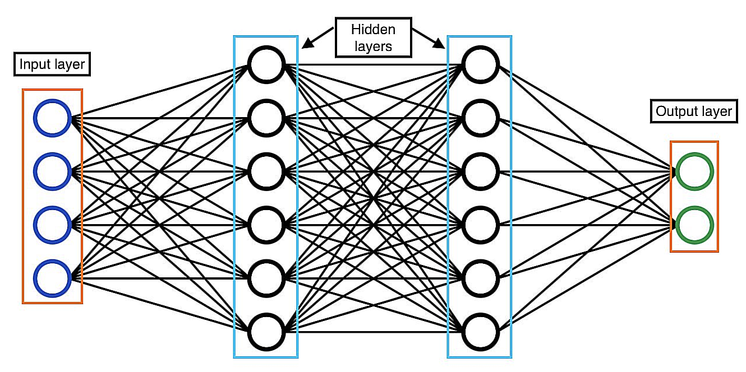
Deep Neural Networks (DNNs)

Slide 38
Deep Neural Networks (DNNs)[1][2]
Activation Functions -
ReLU Activation:
Rectified Linear Unit (ReLU) is a widely used activation function.
It introduces non-linearity and helps the network learn complex patterns.
Sigmoid Activation:
Sigmoid is used in the output layer for binary classification problems.
It squashes values to the range [0, 1], representing probabilities.
Hyperbolic Tangent (tanh):
Similar to the sigmoid but maps values to the range [-1, 1]. It is often used in the hidden layers of DNNs.
Activation Choice Impact:
The choice of activation functions can significantly impact model performance and training speed.

Slide 39
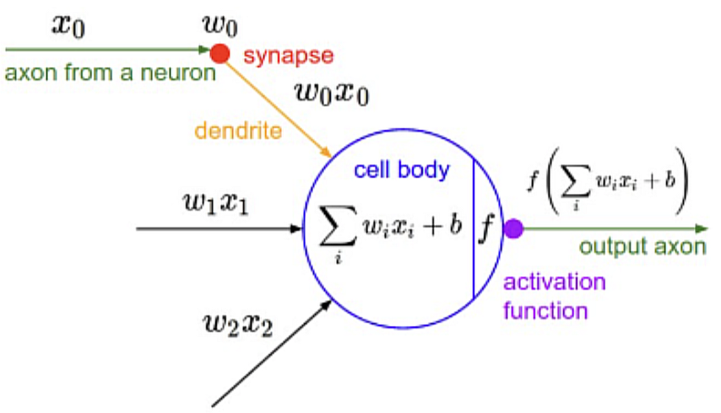
Deep Neural Networks (DNNs)

Slide 40
Convolutional Neural Networks (CNNs)[1][2]
Convolutional Neural Networks Overview -
Introduction:
Convolutional Neural Networks (CNNs) are specialized for processing grid-like data, such as images.
They excel at capturing spatial hierarchies of features.
Architecture:
Convolutional Layers: Detect local patterns using filters.
Pooling Layers: Downsample feature maps, reducing computational load.
Fully Connected Layers: Process high-level features for classification.

Slide 41
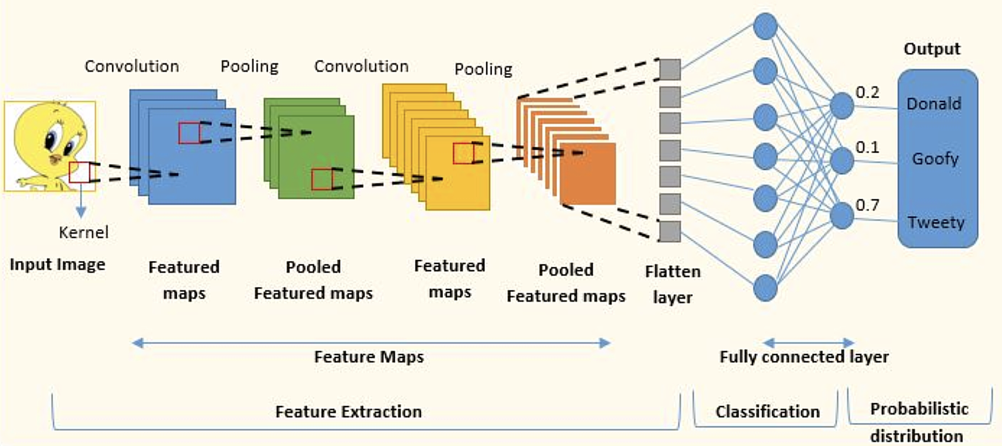
Convolutional Neural Networks (CNNs)[1][2]

Slide 42
Convolutional Neural Networks (CNNs)[1][2]
Convolutional Neural Networks Overview -
Convolutional Operations:
Convolutional layers use filters to scan input, capturing spatial hierarchies of features.
Stride and padding control spatial dimensions.
Applications: Image recognition, object detection, and segmentation are common applications of CNNs

Slide 43
Convolutional Neural Networks (CNNs)[1][2]
Convolution Operations
Convolution Operation:
Convolutional layers apply filters to the input, capturing local patterns.
Feature maps highlight regions of interest.
Pooling Operation:
Pooling layers reduce the spatial dimensions of feature maps, preserving important information.
Common pooling methods include max pooling and average pooling.

Slide 44
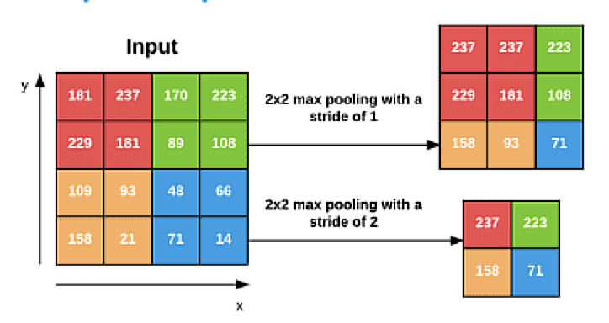
Convolutional Neural Networks (CNNs)

Slide 45
Convolutional Neural Networks (CNNs)[1][2]
Convolution Operations
Hierarchical Feature Learning:
CNNs learn hierarchical representations of features, from simple to complex, aiding in understanding images.
Transfer Learning:
Pre-trained CNN models (e.g., VGG, ResNet) can be fine-tuned for specific tasks, saving training time.

Slide 46
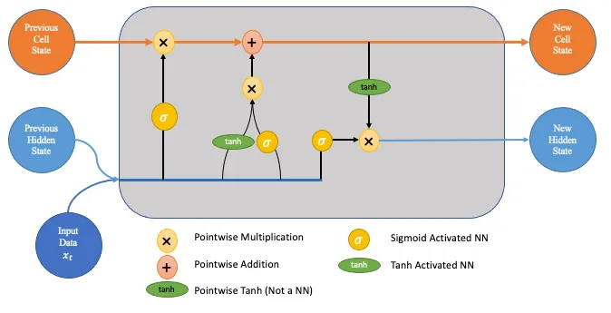
Deep Learning Framework[1][2]
Long Short-Term Memory (LSTM)
A type of recurrent neural network (RNN)
Designed to handle sequential data
Capable of learning long-term dependencies
Well suited for tasks such as language translation, speech recognition, and time series forecasting

Slide 47
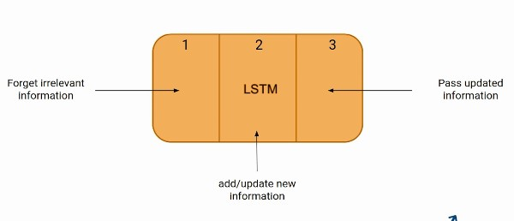
Long Short-Term Memory (LSTM) Architecture
It resolves the vanishing gradient problem faced by RNN, so now, In the next slide, we will see how it resolves this problem by learning the architecture of the LSTM. At a high level, LSTM works very much like an RNN cell. Here is the internal functioning of the LSTM network.
I

Slide 48
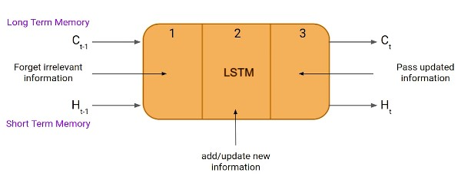
Working of the LSTM framework
Initialization: The LSTM is initialized with a set of parameters, such as the weights and biases of the gates and the memory cell.
Input gate: The input gate controls how much information from the current input is added to the memory cell. It is calculated using the following equation: input_gate = sigmoid(W_i * x_t + U_i * h_{t-1} + b_i)

Slide 49
Working of the LSTM Framework
Forget gate: The forget gate controls how much information from the previous memory cell is forgotten. It is calculated using the following equation: forget_gate = sigmoid(W_f * x_t + U_f * h_{t-1} + b_f)
Update of the memory cell: The memory cell is updated using the following equation: memory_cell = forget_gate * memory_cell_{t-1} + input_gate * tanh(W_c * x_t + U_c * h_{t-1} + b_c)

Slide 50
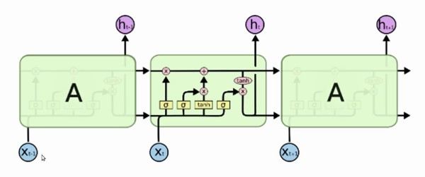
Working of the LSTM Framework
Output gate: The output gate controls how much information from the memory cell is output. It is calculated using the following equation: output_gate = sigmoid(W_o * x_t + U_o * h_{t-1} + b_o)
Output of the LSTM: The output of the LSTM is calculated using the following equation: output = tanh(output_gate * memory_cell)
Iteration: The LSTM iterates over the input sequence, one time step at a time. At each time step, the LSTM calculates the input gate, forget gate, output gate, and memory cell update.

Slide 51
Advantages of LSTM
Vanishing Gradient Problem: LSTMs address the vanishing gradient problem, which is common in vanilla recurrent neural networks (RNNs). The forget gate in LSTM cells allows them to retain information over many time steps without degradation, making them more effective in training and handling long sequences.
Transfer Learning: Pre-trained LSTM models can be fine-tuned for specific tasks, allowing for transfer learning. This is beneficial for reducing the amount of labeled data needed for a new task.
Robust to Noise: LSTMs are robust to noisy data and can handle missing values in sequences. This makes them valuable for real-world data, which often contains irregularities.
Continual Learning: LSTMs can be updated with new data incrementally, which is essential for applications with constantly evolving data, such as stock price prediction or personal assistants.

Slide 52
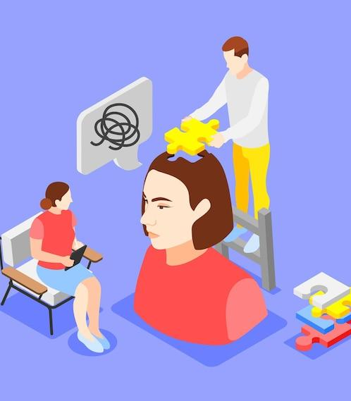
08
Implementation

Slide 53
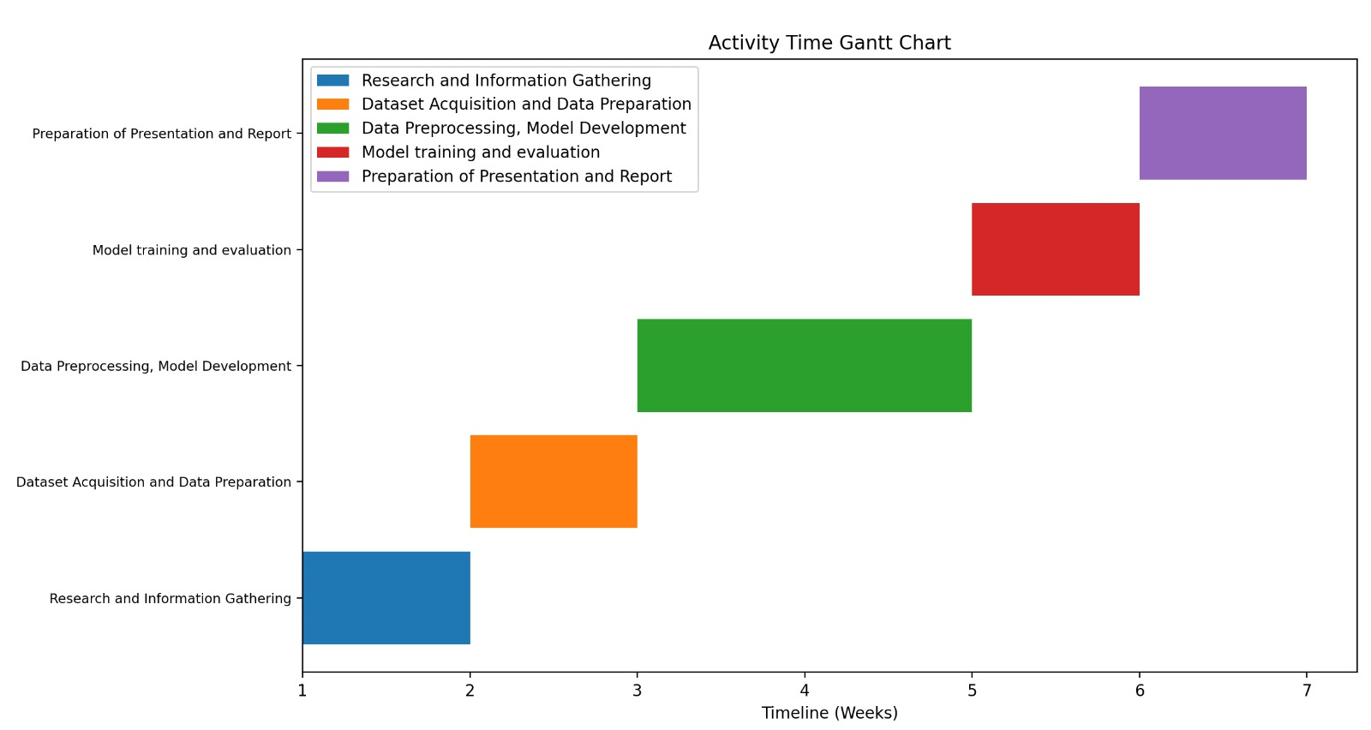

Slide 54
Implementation[A][B]
Platform : This section outlines the tools and libraries used in our machine learning project, focusing on audio-based stress detection using the extended-DAIC WOZ dataset.
scikit-learn (sklearn) train_test_split from sklearn.model_selection: This function plays a fundamental role in supervised machine learning by splitting the dataset into training and testing sets, ensuring model evaluation. LabelEncoder from sklearn. preprocessing: The LabelEncoder is employed to encode categorical labels as integers, a crucial step in making data compatible with machine learning algorithms. confusion_matrix from sklearn. metrics: This function helps assess the performance of classification models by tabulating true positives, true negatives, false positives, and false negatives. classification_report from sklearn. metrics: The classification_report function generates a comprehensive report with precision, recall, F1- score, and support metrics, providing a holistic view of model performance.

Slide 55
Implementation[1]
TensorFlow (tensorflow) Sequential from tensorflow. keras. models: The Sequential class is integral for building sequential neural network models, allowing the stacking of layers in a linear fashion. Dense, Dropout, LSTM, Flatten, Conv1D, MaxPooling1D from tensorflow. keras. layers:These layers are essential for constructing neural network architectures. Dense represents fully connected layers, Dropout helps in mitigating overfitting, LSTM is used for recurrent neural networks, and Conv1D and MaxPooling1D are key components in 1D convolutional neural networks.
Google Colab (google. colab) drive from google. colab: The drive module is utilized to interact with Google Drive within a Google Colab environment, simplifying data storage and retrieval in collaborative online settings. GPU used for training: It’s noteworthy that the project benefited from the GPU (Tesla K80) available in the Google Colab environment, enhancing the efficiency of computations.

Slide 56
Implementation
Working 1. Data Preparation - Define Main Folder - File Paths and Label Names - Loop for File Paths and Labels - Create DataFrames - Display Data - Label Distribution
2. Audio Preprocessing Functions - Function: trimm - Function: pitch.
3. Feature Extraction Functions - Function extract_features Define the extract_feature function
4. Data Loading Functions -Function: load Data -Loading DATA

Slide 57
Implementation
Working 5. DataFrame Creation for Features - X_train DataFrame
6. DataFrame Creation for Labels - y_train DataFrame
7. Label Encoding - LabelEncoder
8. Conversion to NumPy Arrays - Label Arrays - Shape of Label Arrays
9. List of Observed Emotions - observedEmotions is defined as a list containing ’Distressed’ and ’Stressed’.

Slide 58
Implementation
Working 10. Deep Learning Model with Dense Layers (modelDNN) - Model Definition - Model Compilation - Summary of the Model - Display summary of modelDNN - Model Training - Plotting Training History - Confusion Matrix - Classification Report
11. Following similar steps for model with CNN and LSTM layers.

Slide 59
09
GUI
Implementation

Slide 60
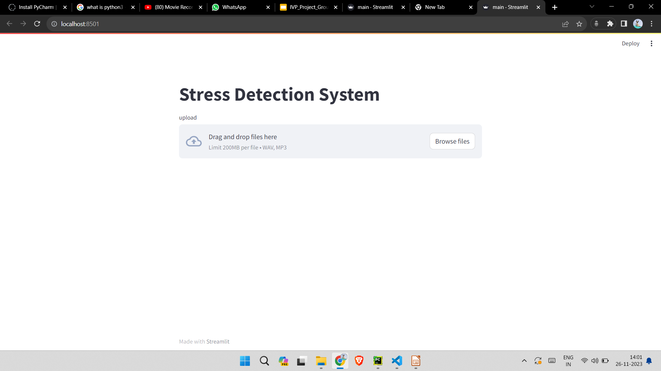
GUI Implementation

Slide 61
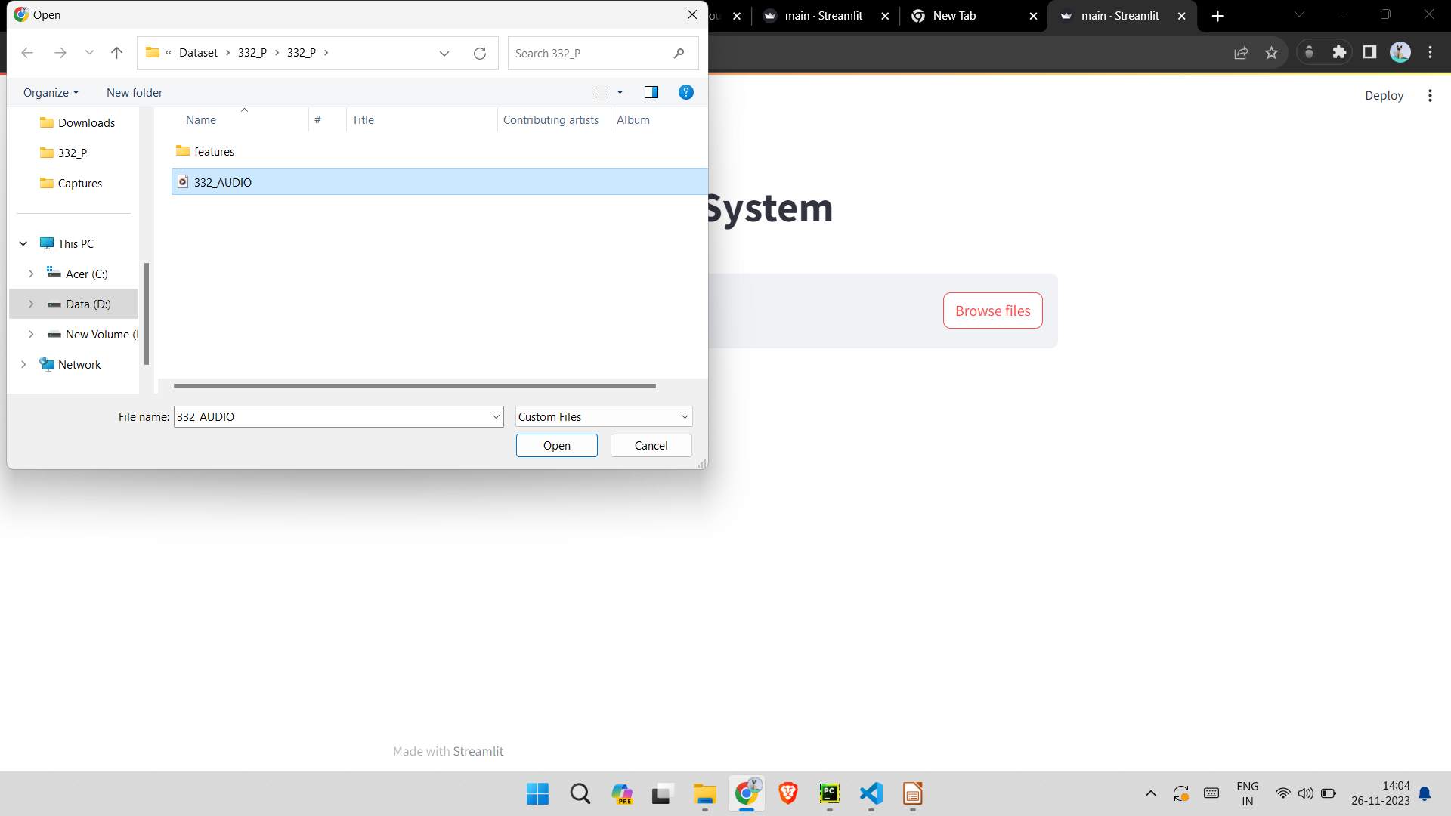
GUI Implementation
How does it works?
We have created a GUI application for our stress detection model which will take audio.wav file as an input
Our uploaded audio file will be saved in
our local directory and our model will predict whether the person in the audio file is stressed or not.

Slide 62
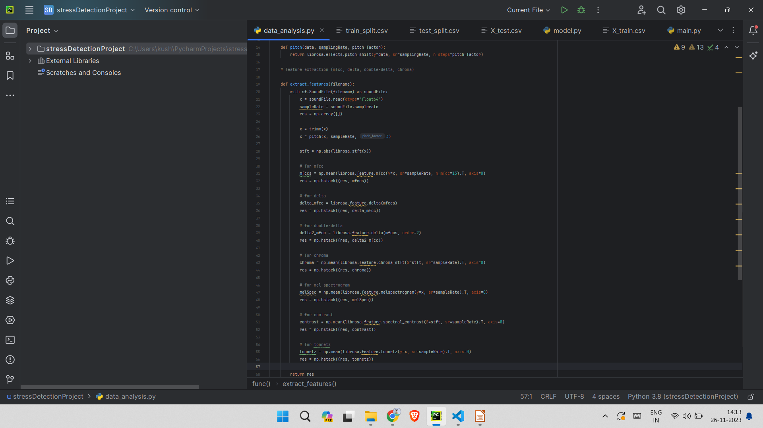
GUI Implementation
How does it works?
Extraction of a total of 192 features of the
Audio files. Now these features will be tested and predicted in our model which has already
Been trained on the diac-WOZ dataset

Slide 63
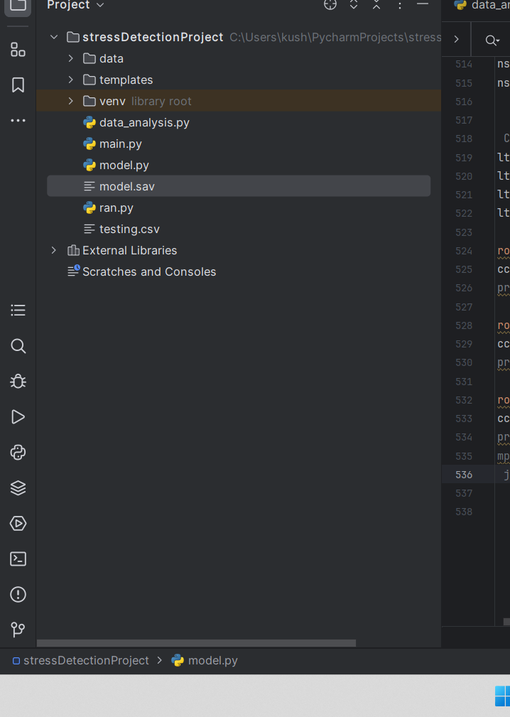
GUI Implementation
How does it works?
Now these features will be trained in our model which has already been trained on the DAIC-WOZ dataset. We have created a dump file using joblib.dump(modelLSTM, 'model.sav')
so that we don’t have to train our model repeatedly.

Slide 64
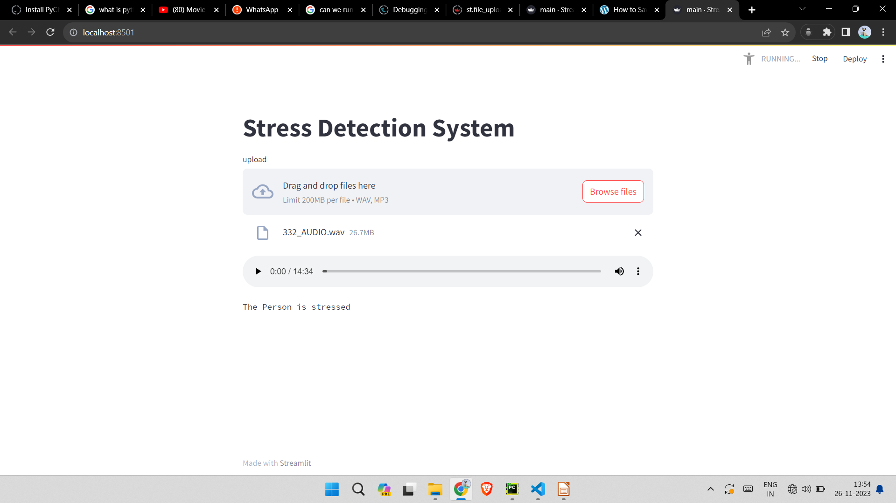
GUI Implementation
How does it works?
After going through the model it, the result
Will be printed whether it is stressed or
Distressed

Slide 65
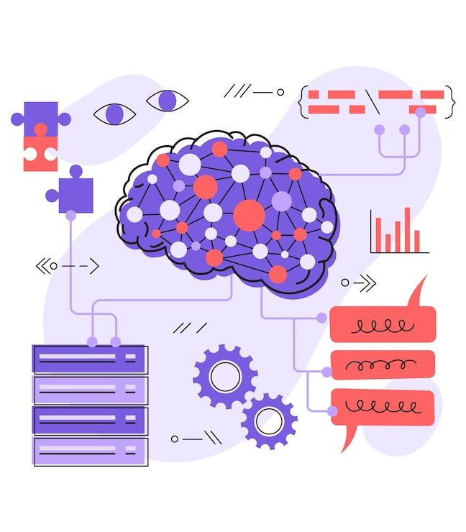
10
Results

Slide 66
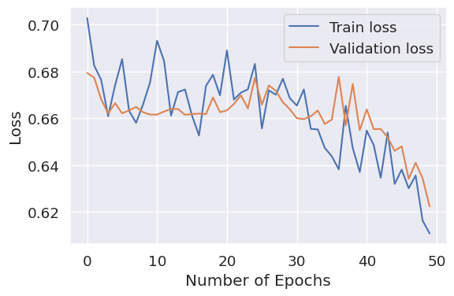
Results
The model was trained with a batch size
of 16 and underwent 50 epochs to optimize
its performance. The input data was
represented by 192 features extracted from
the audio files. A validation split of 15%
was employed to assess the model's
performance on unseen data during
training, ensuring its robustness and
preventing overfitting. A verbosity level
of 1 was set, providing concise training
progress updates, which allowed for
efficient monitoring of the model's learning process.

Slide 67
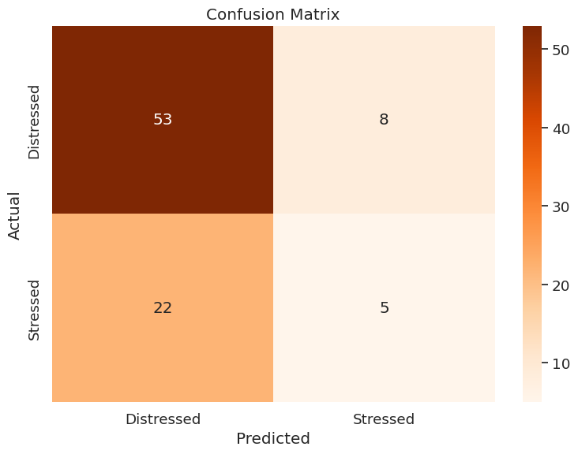
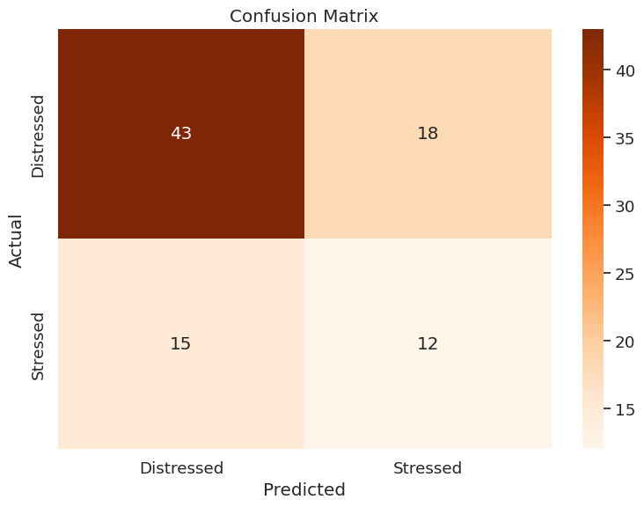
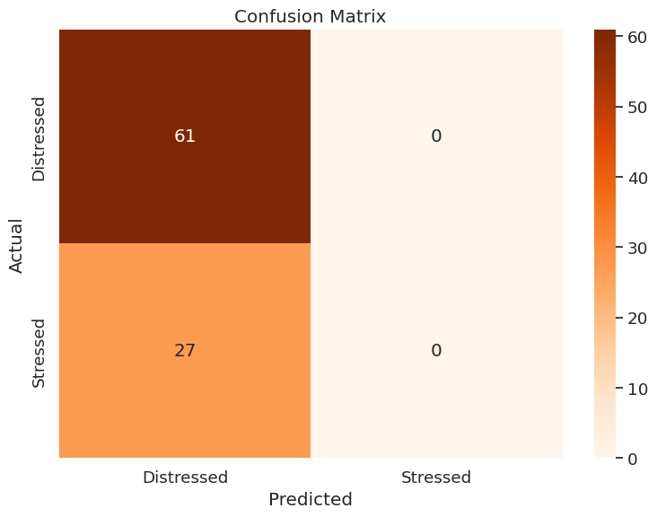
Results - Confusion Matrix
DNN
CNN
LSTM

Slide 68
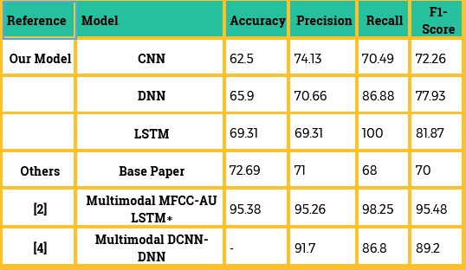
Comparative Analysis

Slide 69

11
Future
Scope &
Limitations

Slide 70
Sample Size and Diversity:
01
Collect more data, if possible, to address the issue of imbalanced data and enhance model performance. Diverse data sources may also be explored.
Implement active learning techniques to strategically select new data points for labeling to improve model generalization and reduce data collection efforts.
02
03
Explore the use of pre-trained models for feature extraction or fine-tuning on a larger and more diverse audio dataset to boost performance.

Slide 71
Representativeness:
The current datasets used in the experiment might not provide an accurate representation of the overall human population.
01
To achieve a more comprehensive understanding of stress triggers and responses, datasets from a broader cross-section of demographics, including various ages, genders, cultures, and socioeconomic backgrounds, should be incorporated.
02

Slide 72
Individual-Based Sensitivity:
Stress sensitivity, indicating the conditions under which individuals experience stress, is highly individualized.
01
This sensitivity can vary significantly from person to person due to personal experiences, genetic factors, and environmental influences.
02
To account for this variability, future research should include datasets that encompass a wide array of stress-inducing scenarios, allowing the neural networks to better generalize individual responses.
03

Slide 73
Improved Generalization:
Exposure to a dataset more representative of the entire human population enables the neural networks to generalize their predictions more effectively.
01
A diverse dataset would help the networks learn patterns and variations in stress responses across different individuals, leading to more accurate predictions in real-world scenarios.
02
The project's scope could include suggestions for future enhancements, such as multi-model integration, real-time feedback, and personalization.
03

Slide 74
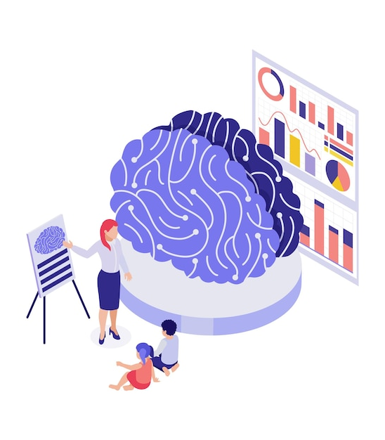
12
Conclusion

Slide 75
Conclusion
In this project, we addressed the challenge of stress detection using deep learning models on the DIAC WOZ dataset.
The dataset, initially small and unbalanced with 105 instances, predominantly belonging to the stressed class, presented a challenge due to data scarcity.
Unable to gather more data and deterred by the prospect of under-sampling, we trained our models on the unbalanced data.
We successfully extracted audio features, including chromagrams, spectrograms, and Mel spectrograms, from trimmed audio files, yielding 192 features from each audio WAV file.
These features were then utilized to identify stress indicators using deep neural networks (DNN), convolutional neural networks (CNN), and long short-term memory networks (LSTM).
In conclusion, this project developed a robust deep learning model for stress detection with commendable accuracy and relevant metrics.
The insights gained are particularly valuable for understanding the significance of audio features and frequency spectrum in stress identification.
While the DIAC WOZ dataset proved invaluable, its limitations should be acknowledged.

Slide 76
13
References

Slide 77
References
L. Yang, D. Jiang and H. Sahli, "Integrating Deep and Shallow Models for Multi-Modal Depression Analysis—Hybrid Architectures" in IEEE Transactions on Affective Computing, vol. 12, no. 01, pp. 239-253, 2021.
Dr. Deepali Godse, Nilofar Mulla, Dr. Rohini Jadhav, Milind Gayakwad, Rahul Joshi, Kalyani Kadam, Jayashree Jahdav. Automated video and Audio based Stress Detection using Deep Learning Techniques. - International Journal on Recent and Innovation Trends in Computing and communication -2023
Mara Naegelin, Raphael P. Weibel, Jasmine I. Kerr, Victor R. Schinazi, Roberto La Marca, Florian von Wangenheim, Christoph Hoelscher, Andrea Ferrario, An interpretable machine learning approach to multimodal stress detection in a simulated office environment, Journal of Biomedical Informatics, Volume 139, 2023.

Slide 78
References
Huijun Zhang, Ling Feng, Ningyun Li, Zhanyu Jin and Lei Cao: Video-Based Stress Detection through Deep Learning, 28/09/2020
Gao, H.; Yüce, A.; Thiran, J. Detecting emotional stress from facial expressions for driving safety. In Proceedings of the IEEE International Conference on Image Processing (ICIP), Paris, France, 27–30 October 2014
Giannakakis, G.; Pediaditis, M.; Manousos, D.; Kazantzaki, E.; Chiarugi, F.; Simos, P.G.; Marias, K.; Tsiknakis, M. Stress and anxiety detection using facial cues from videos. Biomed. Signal Process. Control. 2017.
Mozos, O.M.; Sandulescu, V.; Andrews, S.; Ellis, D.; Bellotto, N.; Dobrescu, R.; Ferrandez, J.M. Stress Detection Using Wearable Physiological and Sociometric Sensors. Int. J. Neural Syst. 2017.

Slide 79
Links
https://dcapswoz.ict.usc.edu/wwwedaic/
Literature Survey
PHQ-9 Test

Slide 80
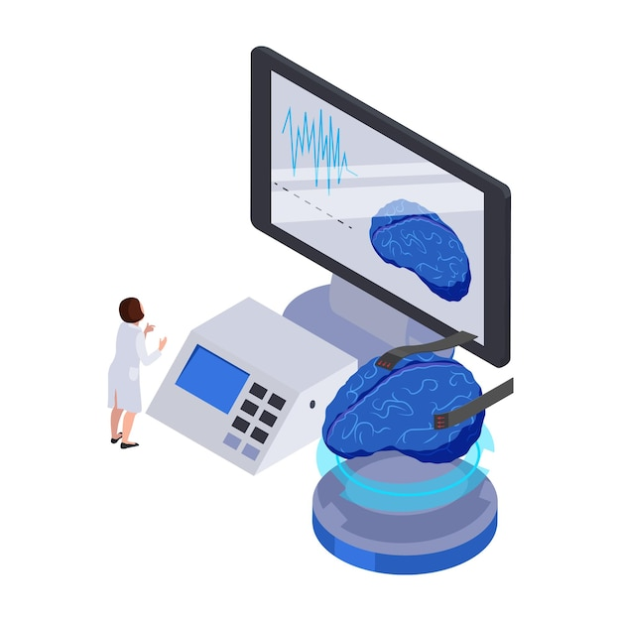
Thank You !

